Slide 1


How diadic homophilic relations leads to structural balance
Stefan Thurner
Zürich Mai 15, 2024

Slide 2
team
Tuan Pham, Jan Korbel, Mirta Galesic, Henrik Olsson,
Rudolf Hanel, Stefan Thurner

Slide 3
social coherence
societies tremendously dynamical
societies tremendously flexible/adaptive
societies innovative
yet obviously coherent: usually don’t “break”

Slide 4
can societies break?

Slide 5
modes of societies breaking
polarization
fragmentation
parallel societies

Slide 6
2 principles of social interactions
humans have tendency towards homophily
humans have a tendency towards “social balance”

Slide 7
homophily
humans tend to have positive relations with similar others
interaction type depends on states of (at least) 2 people
attractive
repulsive

Slide 8
homophily
can be modeled with Ising-type pair interactions

Slide 9
interaction can be more complicated
state = vector → interaction-link is function of matrix
state = matrix → interaction-link is function of tensor
>2 interactors → fct of tensor + higher order interaction

Slide 10
representation of individuals and their interactions
→ see recent work of Mirta Galesic and Henrik Olsson

Slide 11
networks or hypergraphs?
distinction is important if more than 2 nodes interact
vector-based diadic interaction → network
interactions influence each other → hypergraphs or higher order networks

Slide 12
topology of human interaction “networks”?
random component ER
scale free component – negative interactions
small-world component
multiple communities: family, work, leisure
multiple interaction types (multi-layer)
multi-layer Poissonian small-worlds
Pardus game data

Slide 13
interlude

Slide 14

Pardus Game

Slide 15
Pardus Game
~ 480 000 players
temporal resolution 1 sec
since 2004
every possible action recorded
every possible interaction recorded
every possible movement recorded

Slide 16
Pardus Game
people self-organize into groups
friends
clubs
“cities”
hierarchical groups
political parties
organized crime, armies, wars
cartels, banks, courts
“science"
…

Slide 17
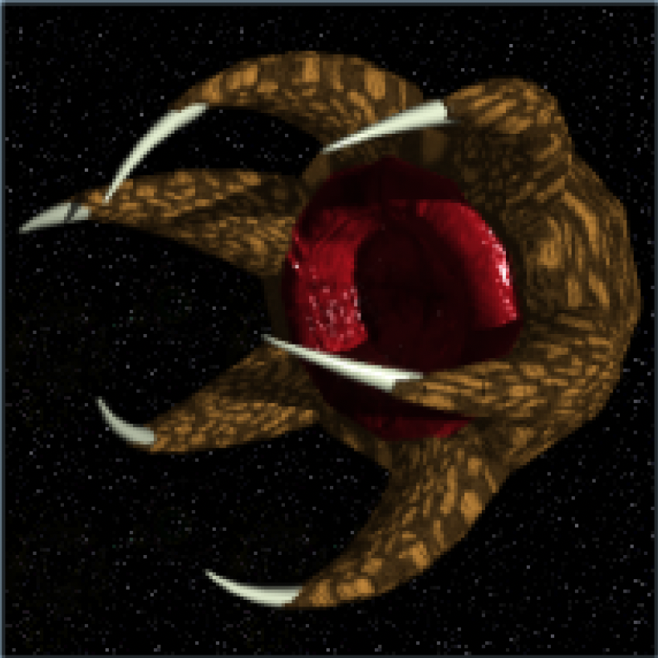
species: spaceclaw

Slide 19
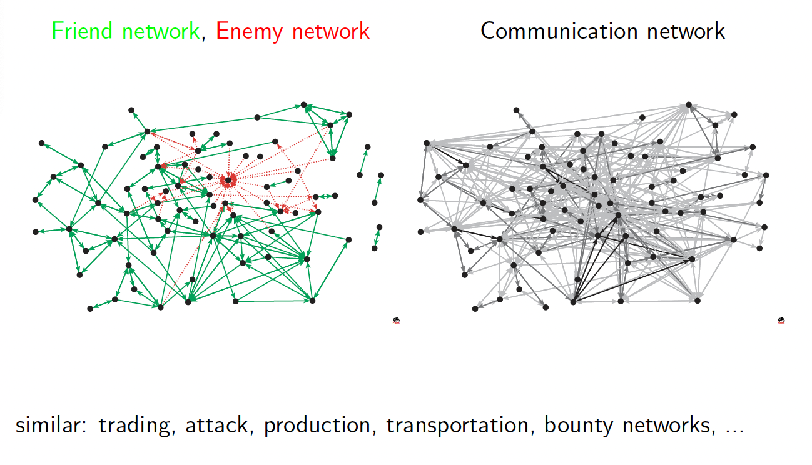

Slide 20
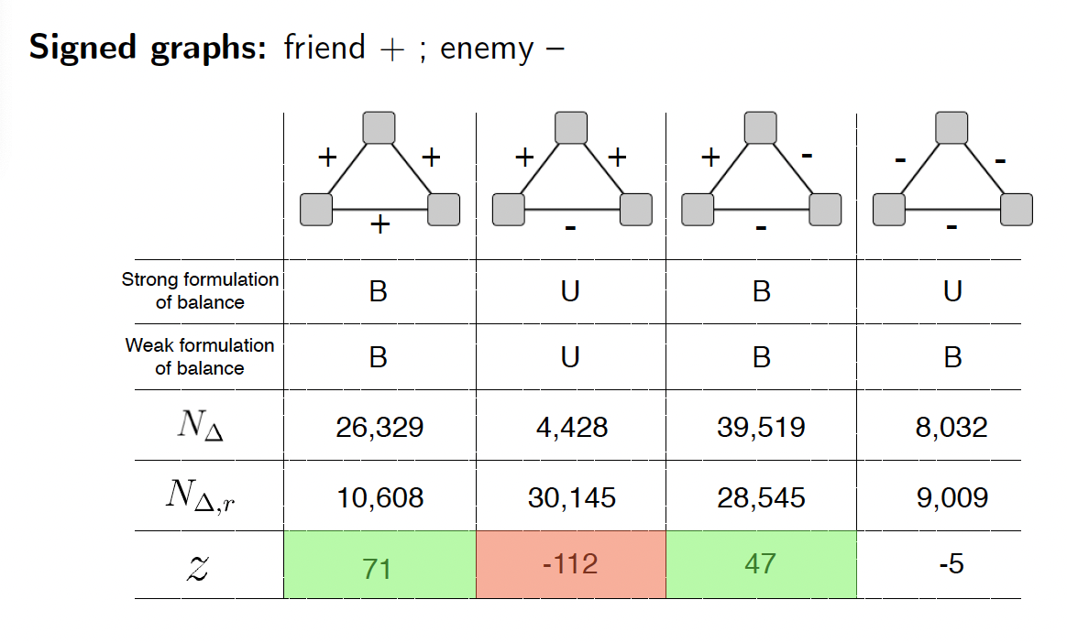

Slide 21
end of interlude

Slide 22
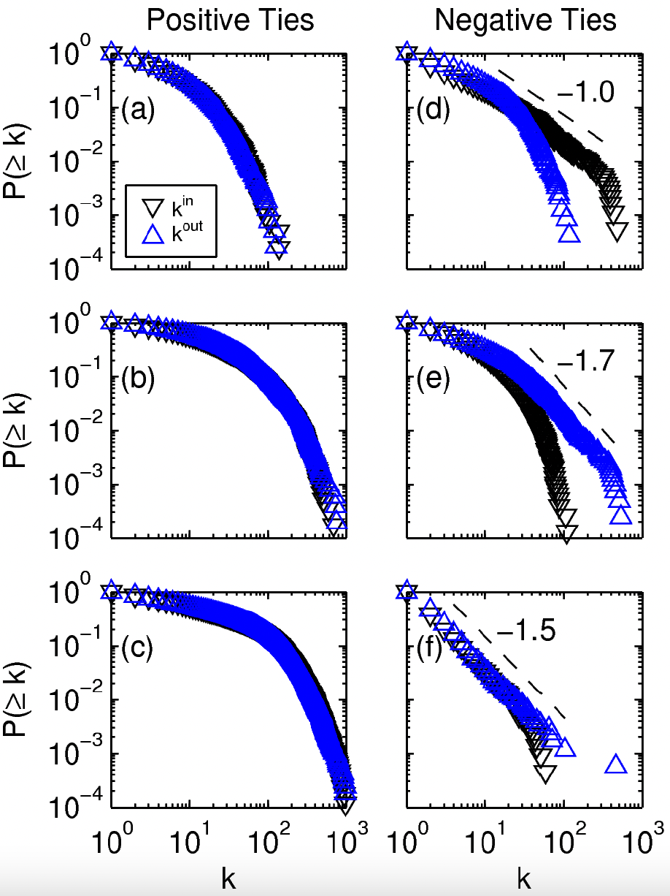
NW topology: random and scale-free aspects
friendship networks have Poissonian, enmity networks scale free degree distributions
* Pardus game data

Slide 23
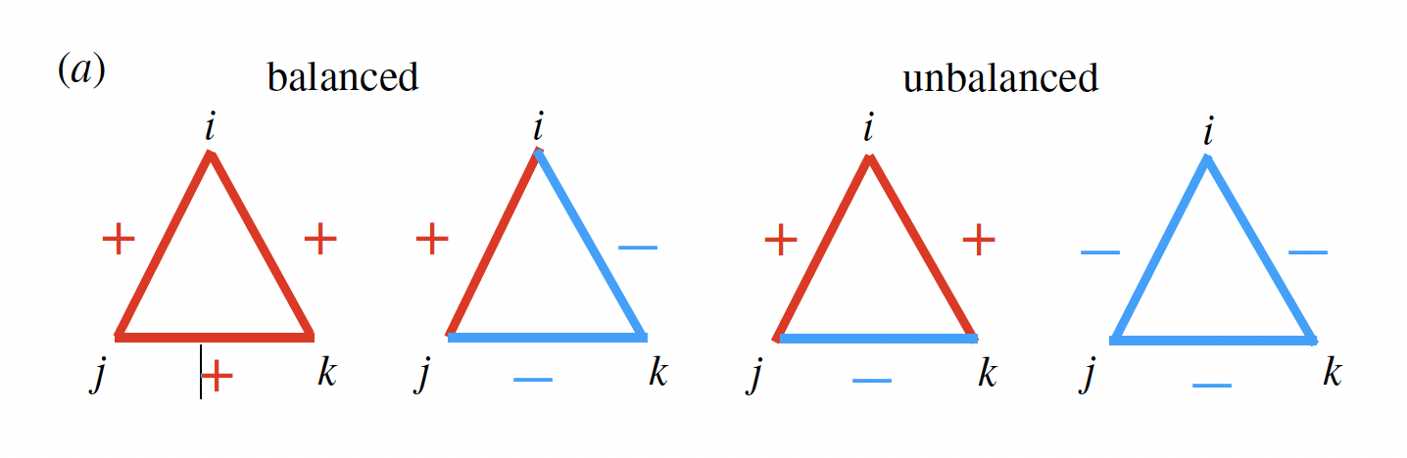
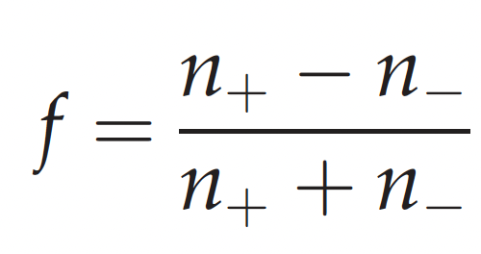
social balance
balanced are usually over represented
a measure of balance

Slide 24
modeling social balance?
to understand social cohesion

Slide 25
minimal requirements to a model of social cohesion
should include homophily and social balance
lead to realistic group-size distributions

Slide 26
simplifications
assume static networks of people you know – type of link can change form positive to negative
partially co-evolutionary
Poissonian ring or Pardus game topologies
binary interaction type: friend – enemy
people represented by opinion vectors (binary)
people update their opinions to minimize social stress
people update their links to minimize social stress

Slide 27
model 1
Roy Soc

Slide 28
model 1: assumptions
humans try to avoid social stress (cognitive dissonance)
→ 2 options: change (some) opinions
change link sign
humans care about social balance

Slide 29
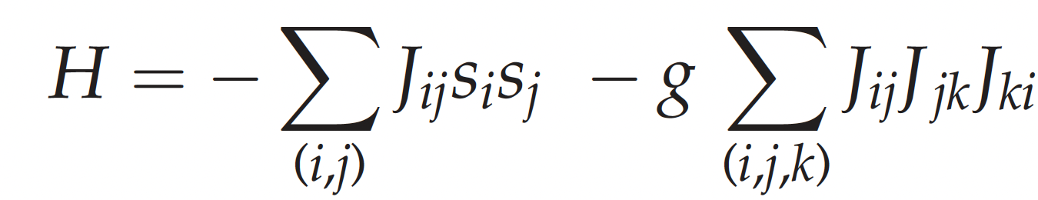
model 1: triadic social balance
model co-evolutionary dynamics with a “Hamiltonian” that quantifies social stress of individual

Slide 30
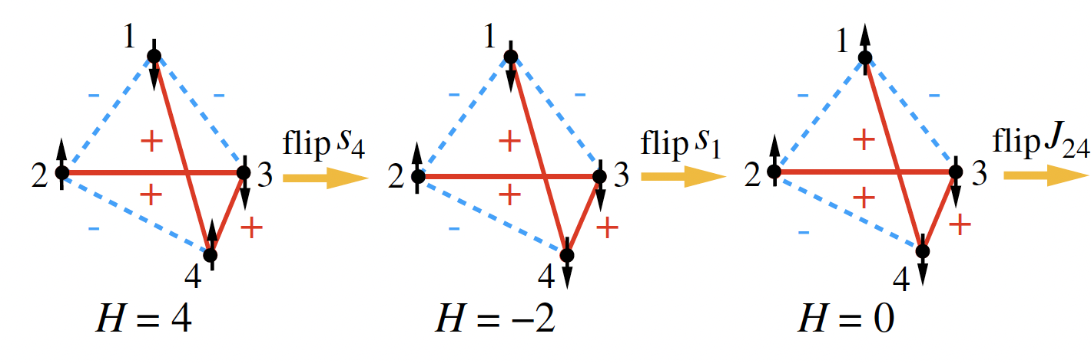
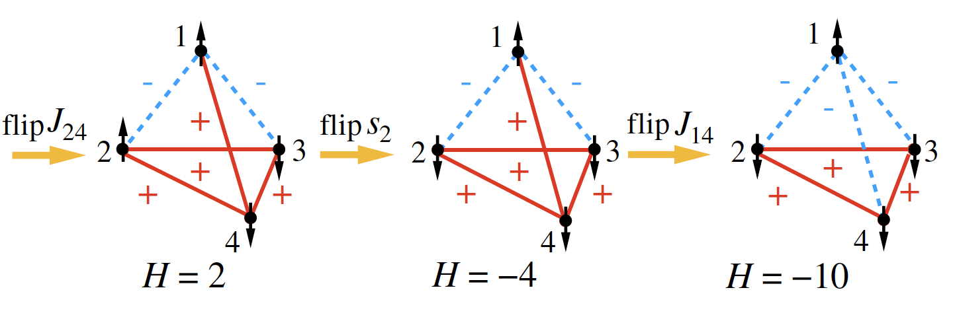
model 1

Slide 31
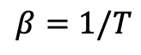
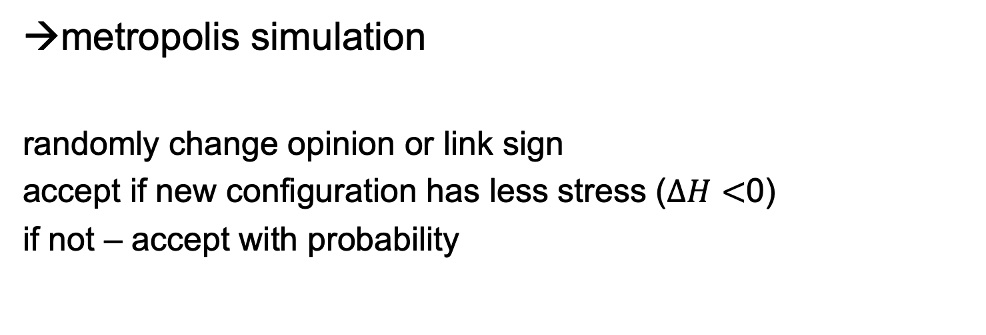
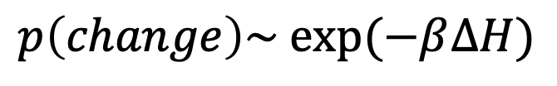
$$β=1/T$$
metropolis simulation
randomly change opinion or link sign
accept if new configuration has less stress ($∆H<$0)
if not – accept with probability
$$p\left(change\right)\sim exp⁡(−β∆H)$$
base NW: 3-lattice, d-dimensional ring, small-worlds, Pardus friends/communication
N ~ O(1000)

Slide 32
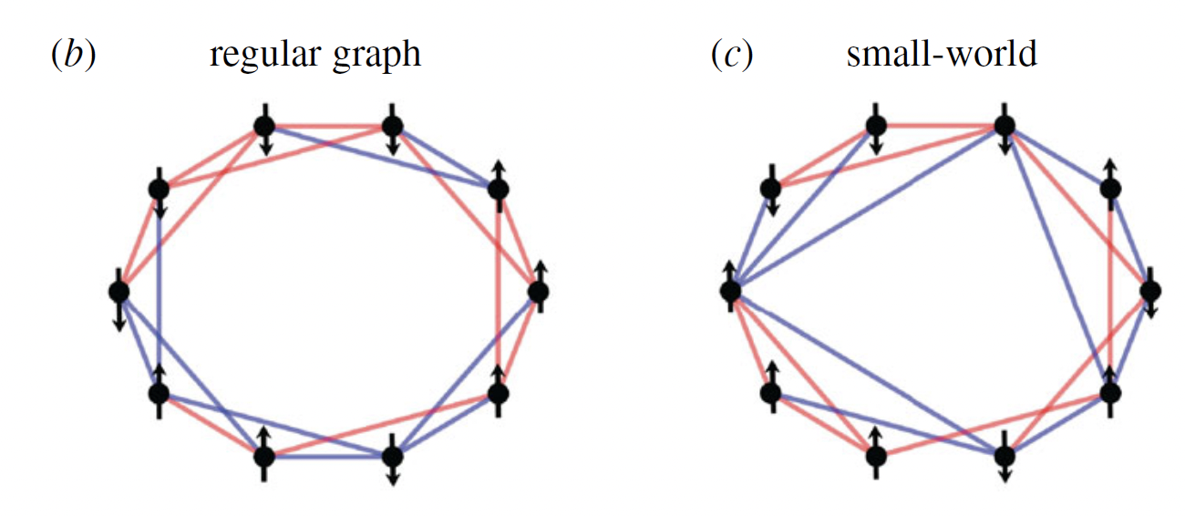

Slide 33
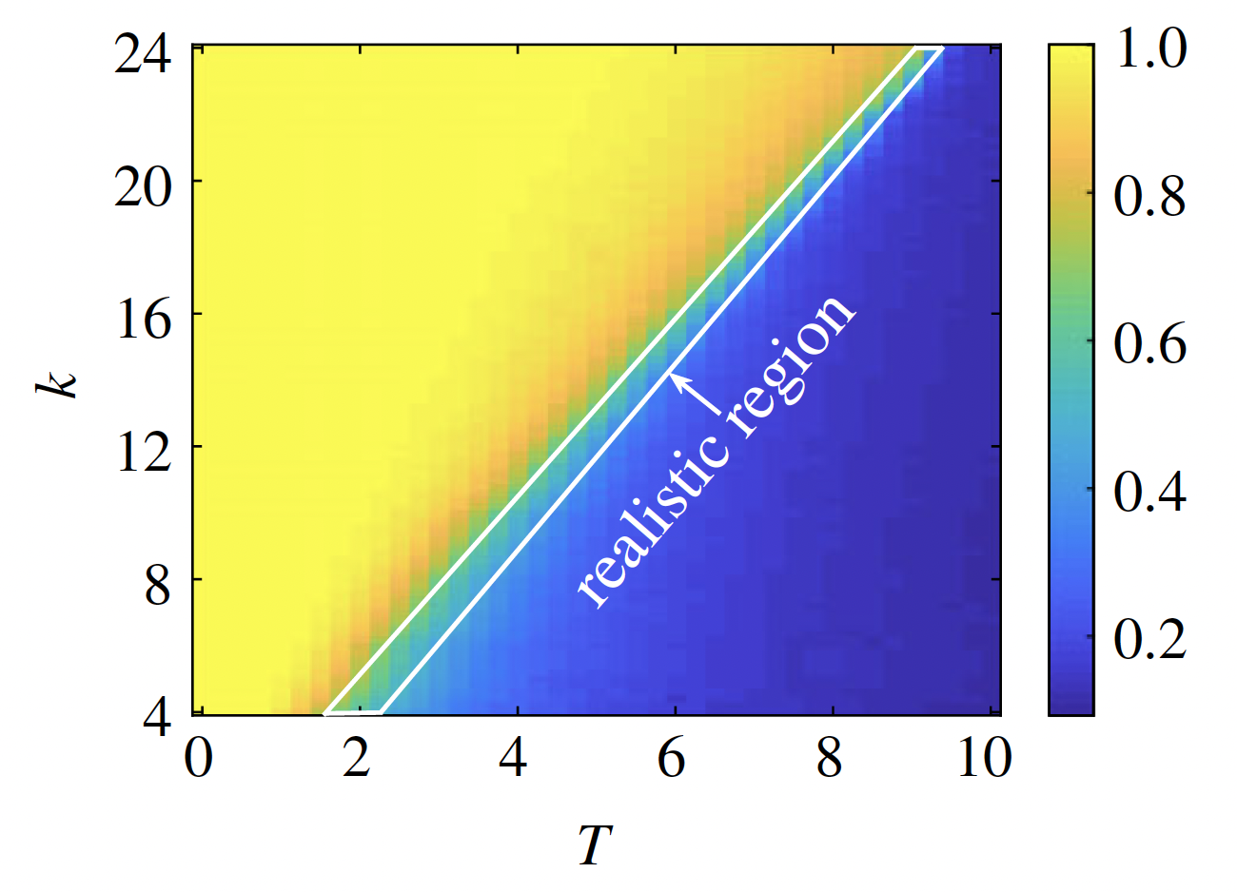
model 1: triadic social balance
color f

Slide 34
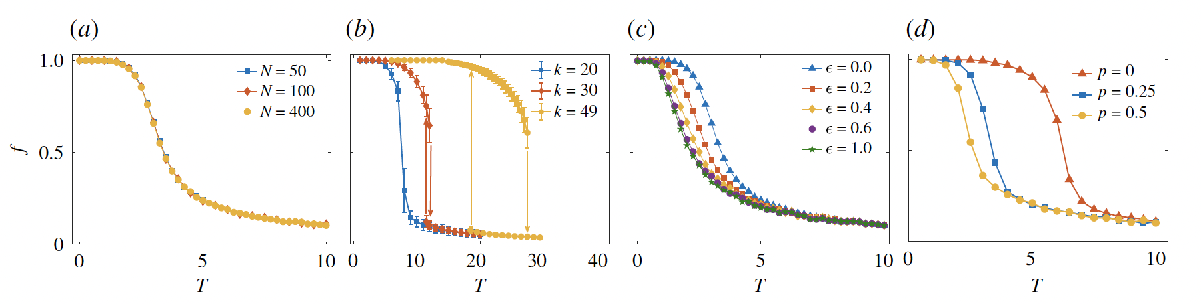
model 1: transition changes nature for high k

Slide 35
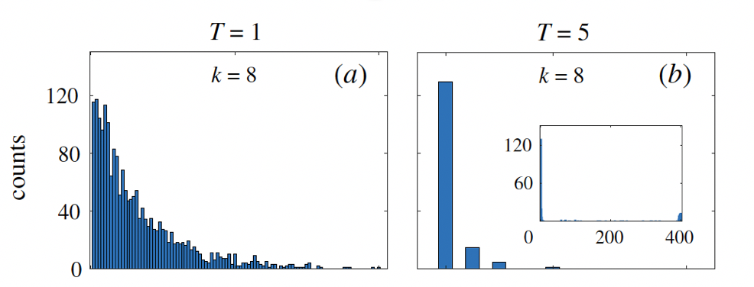
model 1: social fragmentation
society disintegrates into small bubbles at critical point
balanced phase = bubble phase

Slide 36
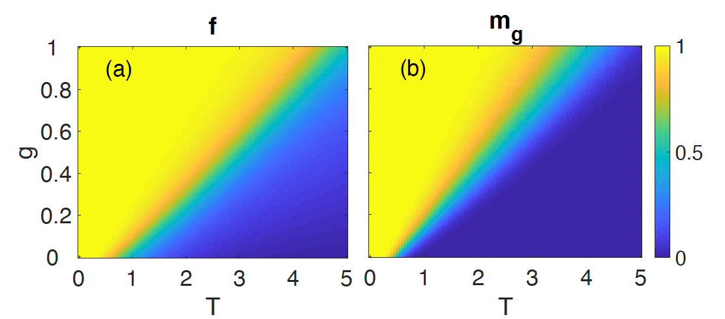
model 1: triadic social balance
m_{g} …. intra-group alignment

Slide 37
model 1: conclusion
social stress reduction with triadic term leads to rewiring such that society disintegrates into small bubbles with positive links within and negative outside
for k>8 the transition is explosive (first order)
social balance put in by hand!
triadic decision making is not very realistic

Slide 38
model 2
PNAS

Slide 39
model 1: assumptions
humans try to avoid (social) stress
humans don’t explicitly care about social balance (because too much information)

Slide 40
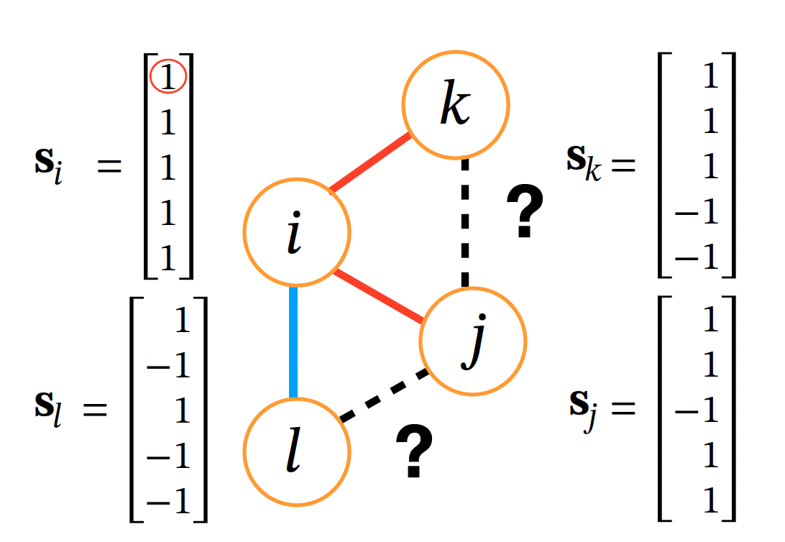
model 2: emergent social balance
multiple opinions

Slide 41
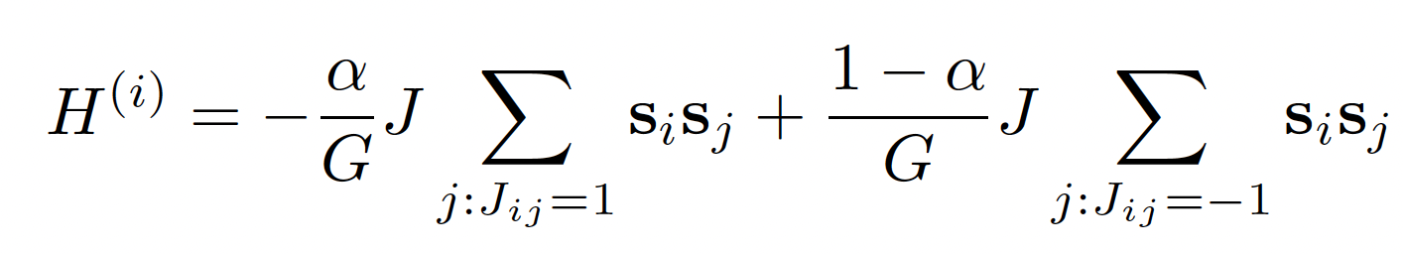
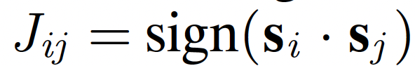
model 2: emergent social balance
stress “Hamiltonian”
with link update rule

Slide 42
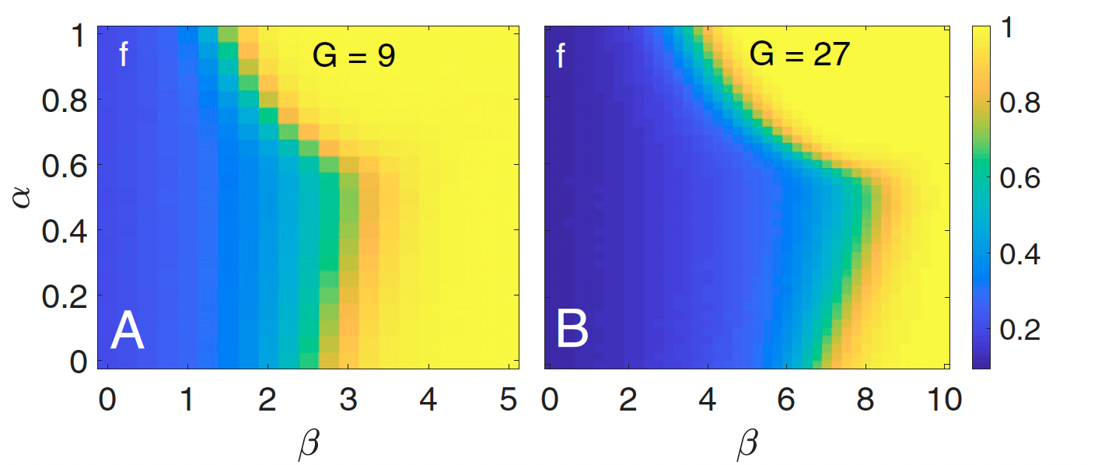
model 2: social balance / phase diagram

Slide 43
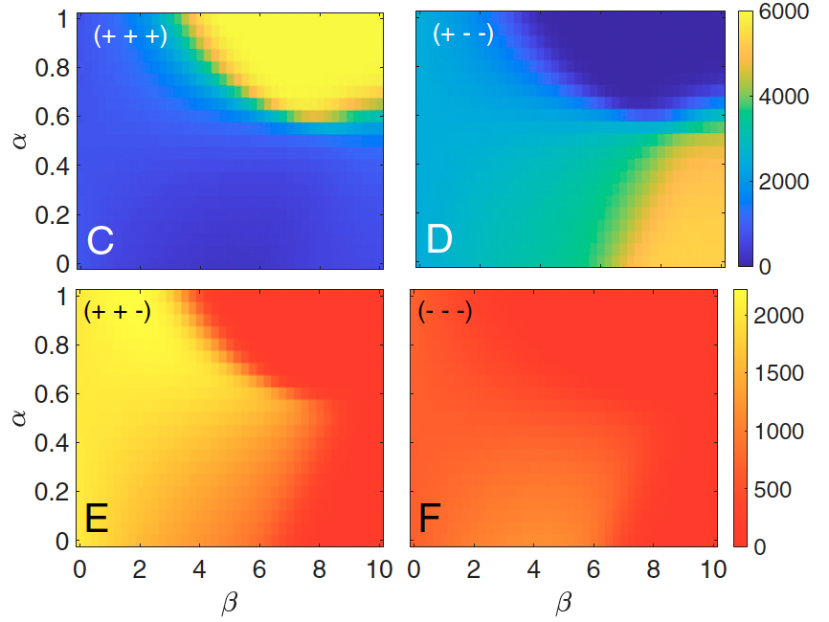
model 2: social balance / phase diagram
triangle counts

Slide 44
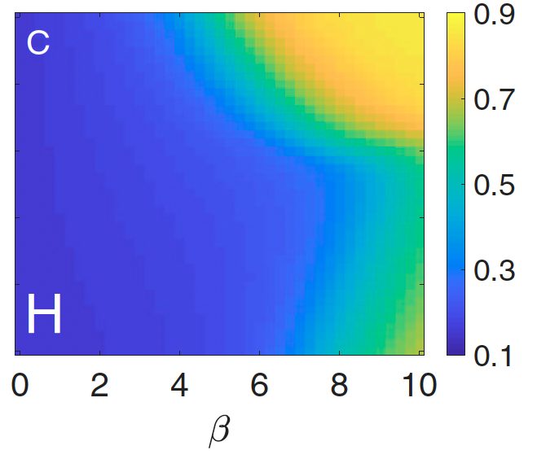
model 2: social balance / phase diagram
opinion correlation

Slide 45
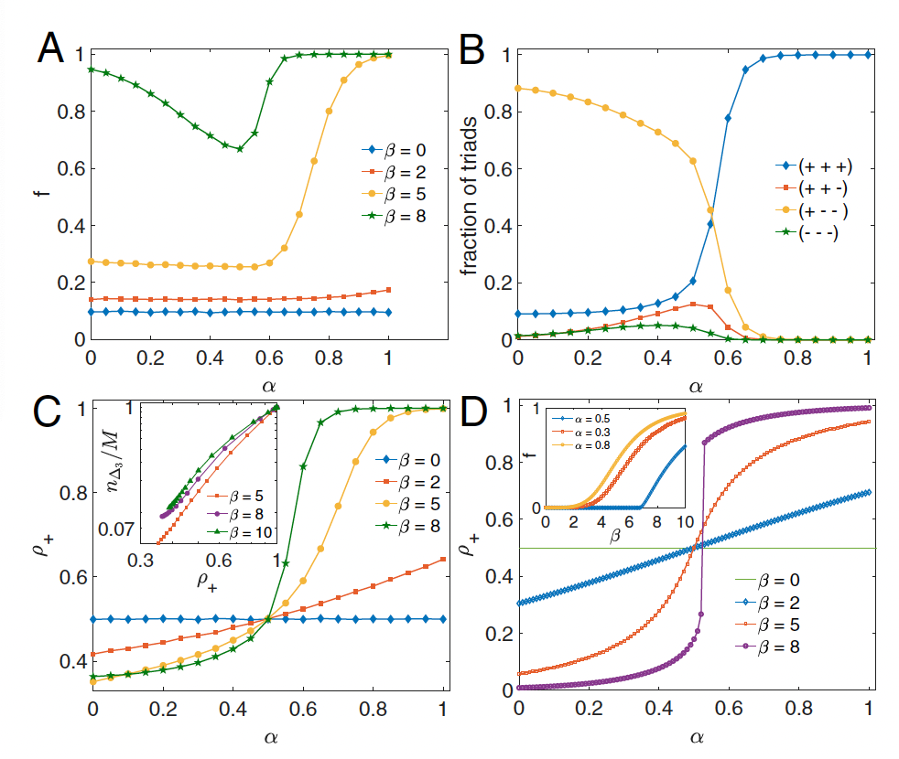
model 2: social balance / phase diagram
parameter
dependence

Slide 46
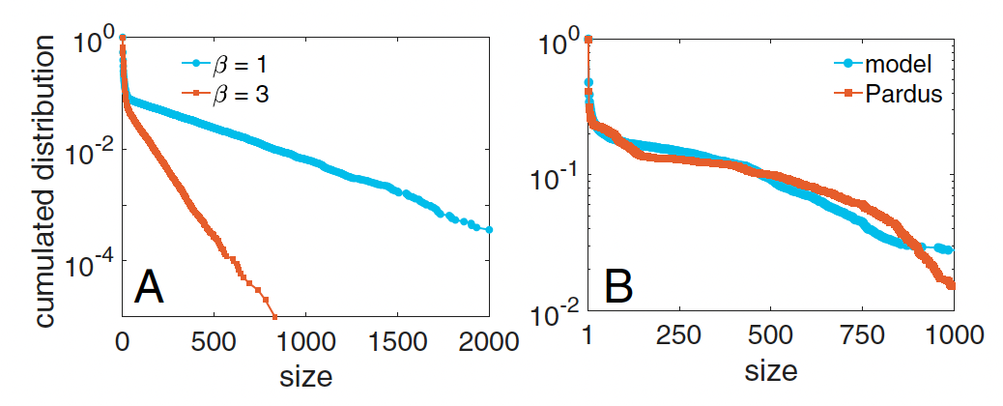
model 2: social balance / group size distribution

Slide 47
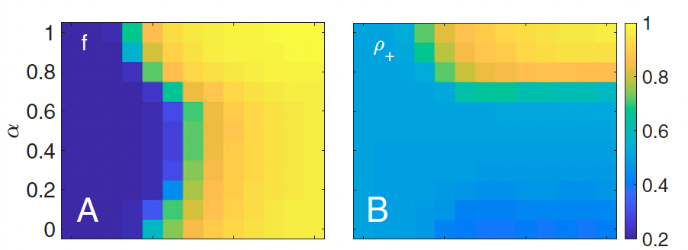
model 2: social balance / Pardus game topology
balance

Slide 48
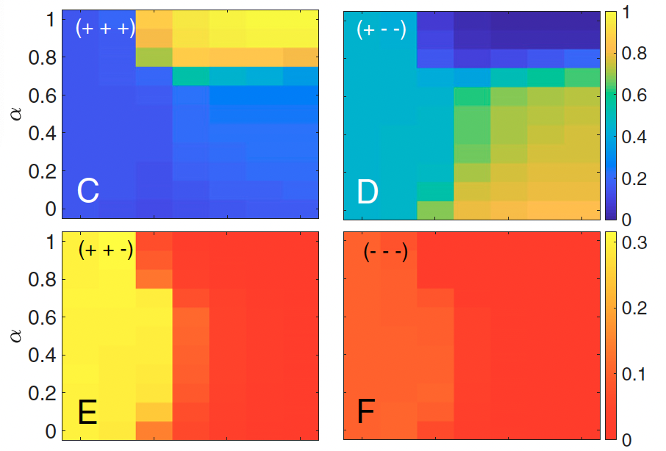
model 2: social balance / Pardus game topology
triangle counts

Slide 49
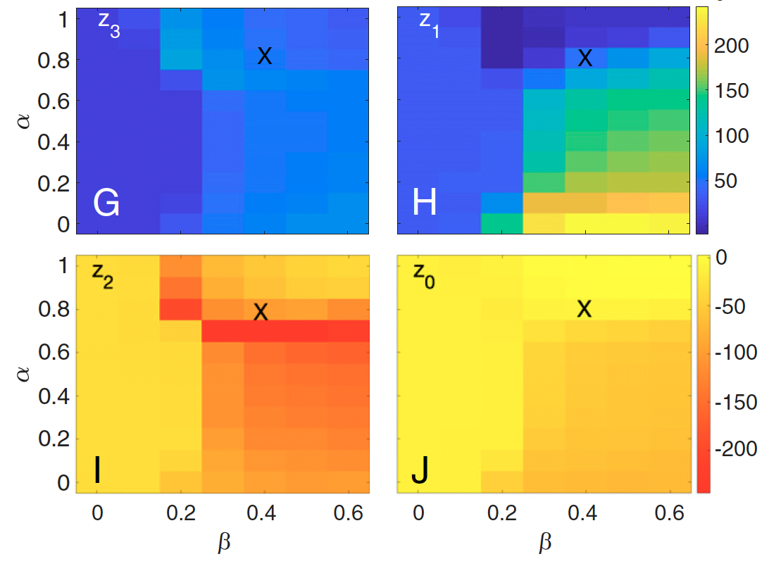
model 2: social balance / Pardus game topology
z-scores
X marks Pardus
parameter estimates

Slide 50
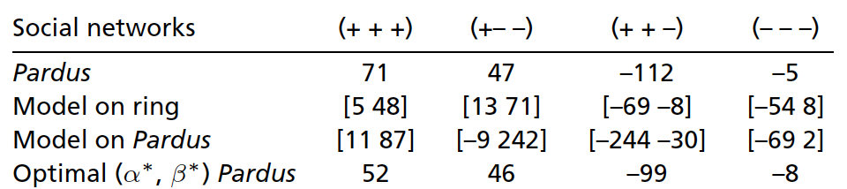
model 2: social balance / z-scores

Slide 51
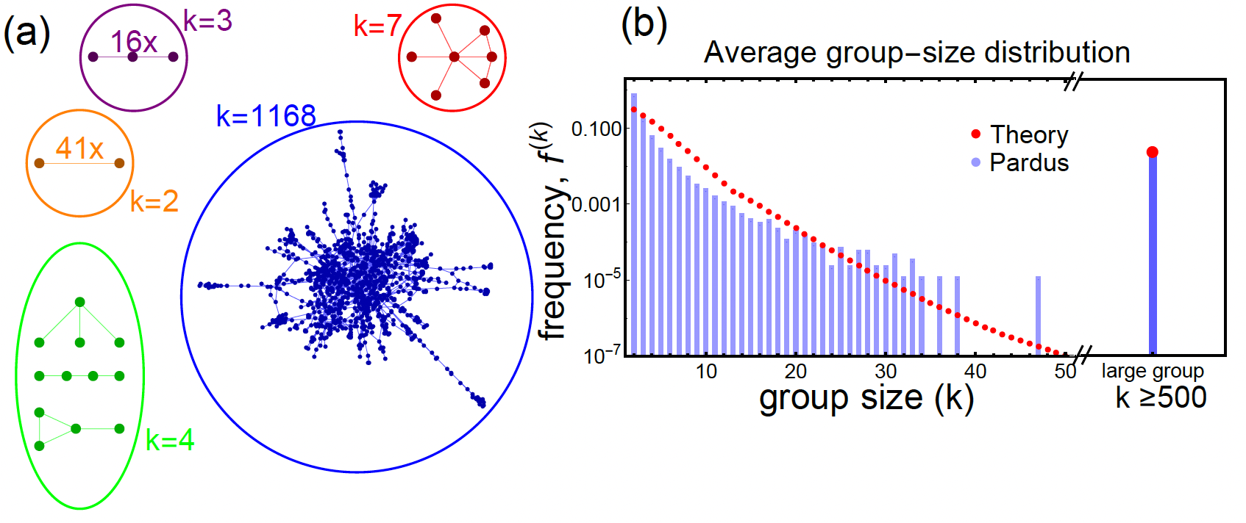
model 2: social balance / group size
z-scores
analytical results, PRL

Slide 52
model 2: conclusion
social balance emerges from diadic interactions
qualitatively similar fragmentation transition
nature of phase transitions analytically computable
when on realistic topologies → good predictions of social balance levels

Slide 53
which model is better?

Slide 54
→ social experiments
online group experiments
longitudinal mechanical turk experiments
480 interacting individuals
asked for naming certain preferences
individuals are given/not given triangle info in tasks (what their friends like/dislike)

Slide 55
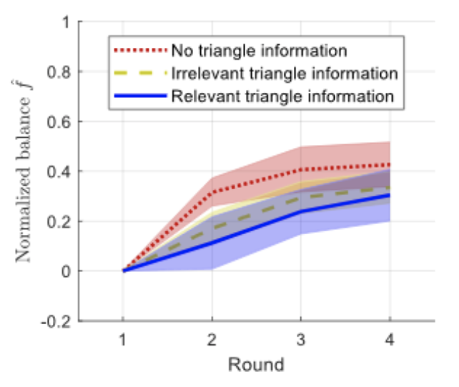
empirical testing of “theories”
social balance emerges very quickly

Slide 56
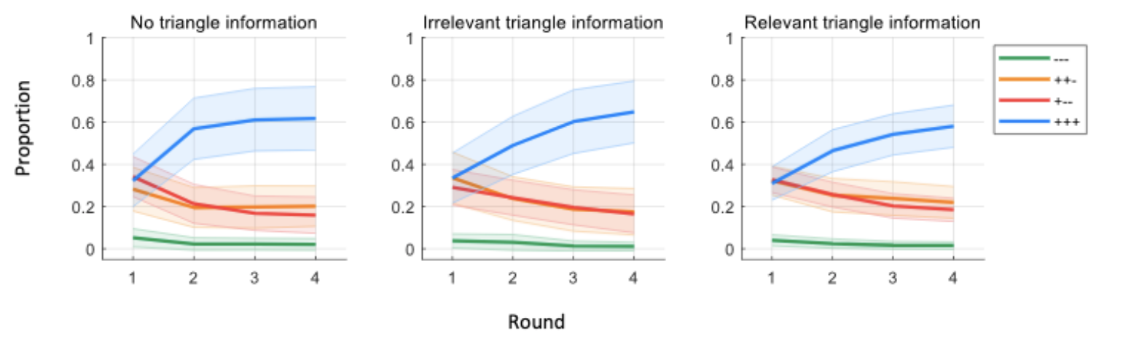
empirical testing of “theories”
triangle counts typical

Slide 57
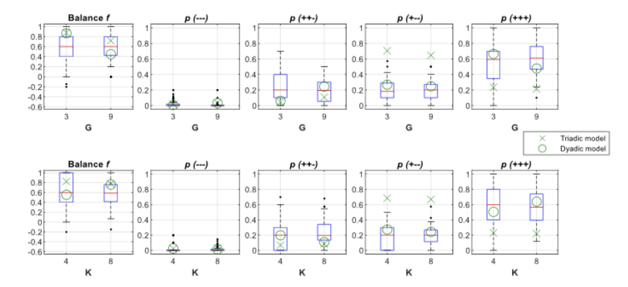
→ diadic model explains data better

Slide 58
References
M. Galesic, H. Olsson, T. Minh Pham, J. Sorger, S. Thurner, Experimental evidence shows that triadic social balance can be achieved through dyadic interactions, in review
J. Korbel, S.D. Lindner, T. Minh Pham, S. Thurner, Homophily-based social group formation in a spin glass self-assembly framework, Physical Review Letters 139 (2023) 057401
T. Minh Pham, J. Korbel, R. Hanel, S. Thurner, Empirical social triad statistics can be explained with dyadic homophylic interactions, Proceedings of the National Academy of Science USA 119 (2022) e2121103119
T. Minh Pham, A. Alexander, J. Korbel, R. Hanel, S. Thurner, Balanced and fragmented phases in societies with homophily and social balance, Scientific Reports 11 (2021) 17188
T. Minh Pham, I. Kondor, R. Hanel, S. Thurner, The effect of social balance on social fragmentation, Journal of the Royal Society Interface 17 (2020) 20200752

